Slide 1
CSE 486/586 Distributed Systems Security --- 2
Steve Ko
Computer Sciences and Engineering
University at Buffalo

Slide 2
Recap
Three types of functions
Cryptographic hash, symmetric key crypto, asymmetric key crypto
Cryptographic hash
Easy to compute h(m)
Hard to find an m, given h(m)
Hard to find two values that hash to the same h(m)
How to find collisions?
Birthday paradox: for 50% prob. & m bits, ~ 2^{m/2} numbers
Symmetric key crypto
MAC: Compute H = AES_{K}(SHA1 (M)) & Send <M, H>
Asymmetric key crypto
Guarantees rely on computational hardness

Slide 3
Recap: Digital Signatures
Method
Signer: compute H = RSA_{K}(SHA1(M)) & send <M, H>
Verifier: compute H’ = RSA_{K’}(H) & verify H’ == SHA1(M)
Not just integrity, but also authenticity

Slide 4
Heard of Firesheep?
Firesheep
A Firefox extension
A packet sniffer to intercept unencrypted cookies from certain websites (such as Facebook and Twitter)
Allows the user to take on the log-in credentials of the victim
Solution?
Encrypt your traffic!
This is before facebook started using https, but now facebook uses https.

Slide 5
“Securing” HTTP
Threat model
Eavesdropper listening on conversation (confidentiality)
Man-in-the-middle modifying content (integrity)
Adversary impersonating desired website (authentication, and confidentiality)
Enter HTTP-S
HTTP sits on top of secure channels
All (HTTP) bytes written to secure channel are encrypted and authenticated

Slide 6



Encrypted Communication
What is wrong with this?
How do you know you’re actually talking to facebook and f-pub belongs to facebook?
Hey, I want to be more secure
Sure, use this public key and encrypt your traffic
Key: f-pub
(encrypted communication)

Slide 7
Digital Certificates
A digital certificate is a statement signed by a third party principal, and can be reused
e.g., Verisign Certification Authority (CA)
To be useful, certificates must have:
A standard format, for construction and interpretation
A protocol for constructing chains of certificates
A trusted authority at the end of the chain
Example
When facebook sends you the public key, it also sends a signature for the public key signed by Verisign.
You pre-store Verisign’s public keys & certificates (self-signed by Verisign), i.e., you have already established trust with Verisign.
Use Verisign’s public key to verify facebook’s public key.

Slide 8
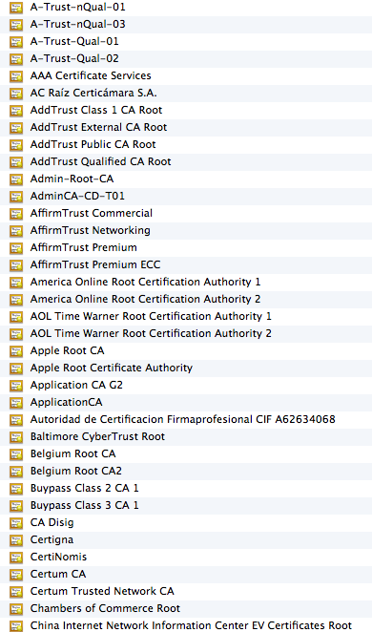
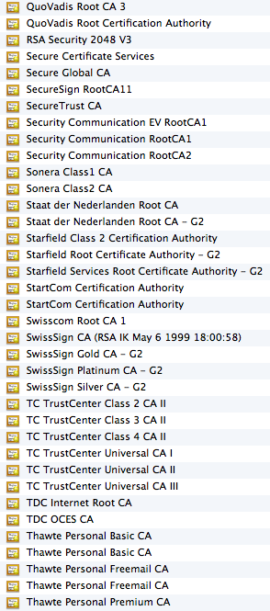
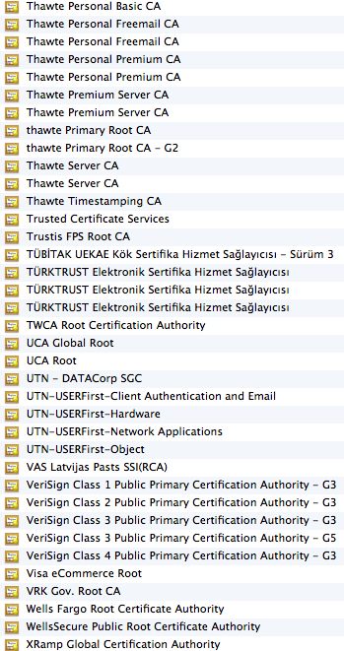
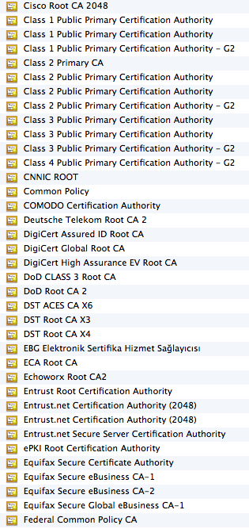
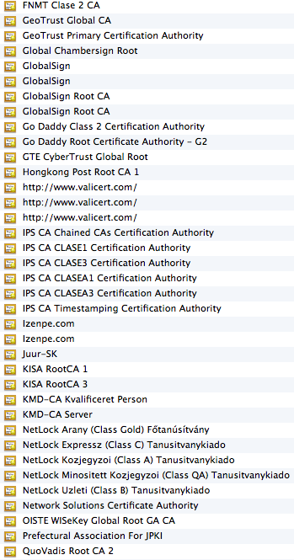
On My Mac…

Slide 9
X.509 Certificates
The most widely used standard format for certificates
Format
Subject: Distinguished Name, Public Key
Issuer: Distinguished Name, Signature
Period of validity: Not Before Date, Not After Date
Administrative information: Version, Serial Number
Extended information
Binds a public key to the subject
A subject: person, organization, etc.
The binding is in the signature issued by an issuer.
You need to either trust the issuer directly or indirectly (by establishing a root of trust).

Slide 10
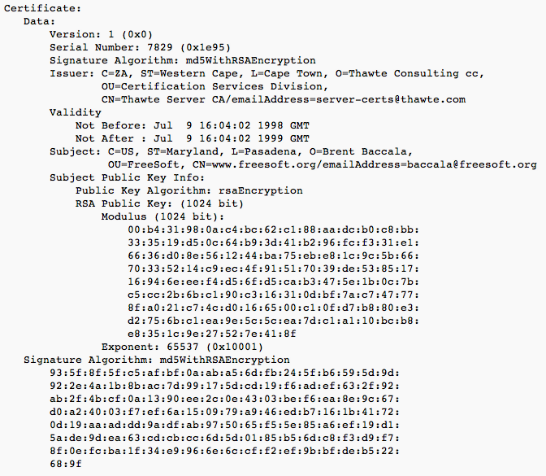
X.509 Certificates

Slide 11
Transport Layer Security (TLS)
SSL (Secure Socket Layer) was developed by Netscape for electronic transaction security.
SSL was adopted as TLS as an Internet standard.
A protocol layer is added below the application layer for:
Negotiating encryption and authentication methods.
Bootstrapping secure communication
It consists of two layers:
The Record Protocol Layer implements a secure channel by encrypting and authenticating messages
The Handshake Layer establishes and maintains a secure session between two nodes.

Slide 12
TLS Protocol Stack
TLS
Handshake
TLS Change
TLS Alert
Cipher Spec
Protocol
HTTP
Telnet
protocol
TLS Record Protocol
Transport layer (usually TCP)
Network layer (usually IP)
TLS protocols:
Other protocols:

Slide 13
TLS Record Protocol
The record protocol takes an application message to be transmitted,
fragments the data into manageable blocks,
optionally compresses the data,
computes a message authentication code (MAC),
encrypts and
adds a header.
abcdefghi
Application data
Fragment/combine
Record protocol units
abc
def
ghi
Compress
Compressed units
Hash
MAC
Encrypt
Encrypted
Transmit
TCP packet

Slide 14
TLS Handshake Protocol
Cipher suite: a list of cryptographic
algorithm supported by the client
Phase 1: Establish security capabilities
Phase 2: Sever authentication and key exchange
Phase 3: Client authentication and key exchange
Phase 4: Finish
The client sends a change Cipher Spec
message and copies the pending
CipherSpec into the current CipherSpec.

Slide 15
CSE 486/586 Administrivia
CSE 622 Advanced Computer Systems
Probably on Android platform
Is open for registration
PA4 due this Friday @ 2:59pm.
Will target finishing up grading next week.
PA3 grading underway
Will be done this week.
Final: 5/6, Monday, 3:30pm – 6:30pm
Davis 101
Everything up to this Friday
Anonymous feedback form still available.
Please come talk to me!

Slide 16
Authentication
Use of cryptography to have two principals verify each others’ identities.
Direct authentication: the server uses a shared secret key to authenticate the client.
Indirect authentication: a trusted authentication server (third party) authenticates the client.
The authentication server knows keys of principals and generates temporary shared key (ticket) to an authenticated client. The ticket is used for messages in this session.
E.g., Verisign servers

Slide 17
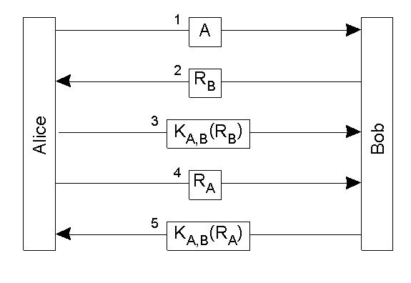
Direct Authentication
Authentication with a secret key
“Nonce”=random num,
Bob calculates K_{A,B} (R_{B} )
and matches with reply.
Alice is the only one
who could have
replied correctly.

Slide 18
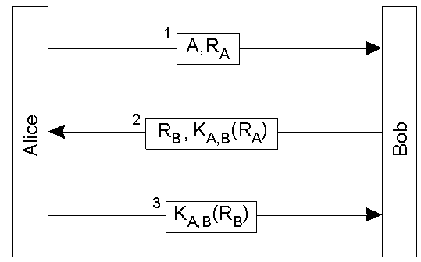
“Optimized” Direct Authentication
Authentication with a secret key with three messages
Anything wrong with this?

Slide 19
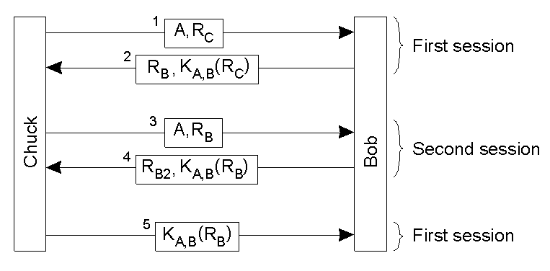
Reflection Attack

Slide 20
Needham-Schroeder Authentication
An authentication server provides secret keys.
Every client shares a secret key with the server to encrypt their channels.
If a client A wants to communicate with another client B,
The server sends a key to the client A in two forms.
First, in a plain form, so that the client A can use it to encrypt its channel to the client B.
Second, in an encrypted form (with the client B’s secret key), so that the client B can know that the key is valid.
The client A sends this encrypted key to the client B as well.
Basis for Kerberos

Slide 21
Needham-Schroeder Authentication
A asks for a key to communicate with B
“Nonce”=random num,
Authentication System
K_{A} K_{B} …
<A, B, N_{A}>
Ticket
1
2
System A
<N_{A},B,K_{AB}, {K_{AB}, A} >
K_{B}
K_{A}
K_{A}
3
< {K_{AB}, A} >
K_{B}
System B
5
< {N_{B}} >
K_{AB}
4
A demonstrates
that it is the sender
of the previous
message
< {N_{B}-1, req} >
K_{B}
K_{AB}
< {res} >
6
K_{AB}

Slide 22
Nonce N_{A} in Message 1
Because we need to relate message 2 to message 1
Authentication System
1’
<A, B>
K_{A} K_{B} …
<A, B>
1
2
System A
<B, K_{AB}, {K_{AB}, A} >
K_{B}
K_{A}
K_{A}
System C
Chuck has stolen K_{B} and
intercepted message 2.
It can masquerade as the
authentication system.
<B, K_{AB}, {K_{AB}, A} >
K_{B}
K_{B}
K_{A}
2’
<B, K_{AB}, {K_{AB}, A} >
K_{B}
K_{A}

Slide 23
Kerberos
Follows Needham-Schroeder closely
Time values used for nonces
To prevent replay attacks
To enforce a lifetime for each ticket
Very popular
An Internet standard
Default in MS Windows

Slide 24
Kerberos
Kerberos Key Distribution Centre
Authentication
Step A
database
Ticket-
Authen-
granting
1. Request for
tication
service T
TGS ticket
service A
2. TGS
ticket
Step B
3. Request for
server ticket
Login
4. Server ticket
Step C
session setup
5.
Service
Server
request
Service
Client
session setup
Server
C
Request encrypted with session key
function
S
DoOperation
Reply encrypted with session key

Slide 25
Summary
Digital certificates
Binds a public key to its owner
Establishes a chain of trust
TLS
Provides an application-transparent way of secure communication
Uses digital certificates to verify the origin identity
Authentication
Needham-Schroeder & Kerberos

Slide 26
Acknowledgements
These slides contain material developed and copyrighted by Indranil Gupta (UIUC), Jennifer Rexford (Princeton) and Michael Freedman (Princeton).

